Slide 1



Noida Institute of Engineering and Technology, Greater Noida
Turing Machine
UNIT 5
Unit: 5
TAFL
Dr. Hitesh Singh
Assistant Professor
IT
Course Details (B Tech 4th Sem)

Slide 2
Content
Introduction
Formal definition of Turing machine
TM Examples
Universal Turing Machine
Linear Bounded Automata
Church’s Thesis
Recursive Enumerable
Halting Problem
Post Correspondence Problem
Dr. Hitesh Singh KCS - 402 TAFL Unit Number: 5

Slide 3
Course Objective
Introduce concepts in automata theory and theory of computation
Identify different formal language classes and their relationships
Design grammars and recognizers for different formal languages
Prove or disprove theorems in automata theory using its properties
Determine the decidability and intractability of computational problems
Dr. Hitesh Singh KCS - 402 TAFL Unit Number: 5

Slide 4
Course Outcome
Theory of Automata and Formal Languages (KCS-402)
Course Outcome (CO) |  | Bloom’s Knowledge Level (KL)
At the end of the course, the student will be able to understand
CO 1 | Analyze and design finite automata, pushdown automata, Turing machines, formal languages and grammars. |  | K4, K6
CO 2 | Analyze and design, Turing Machine, formal languages and grammars. |  | K4, K6
CO 3 | Demonstrate the understanding of key notions, such as algorithms, computability, decidability and complexity through problem solving. |  | K1, K5
CO 4 | Prove the basic result of the Theory of Computation. |  | K2, K3
CO 5 | State and explain the relevance of the Church Turing Thesis. |  | K1, K5

Slide 5
CO-PO and PSO Mapping
CO-PO correlation matrix of Theory of Automata and Formal Languages (KCS 402)
 | PO1 | PO2 | PO3 | PO4 | PO5 | PO6 | PO7 | PO8 | PO9 | PO10 | PO11 | PO12
KCS402.1 | 2 | 2 | 3 | 3 | 2 | 2 | - | - | 2 | 1 | - | 3
KCS402.2 | 1 | 3 | 2 | 3 | 2 | 2 | - | 1 | 1 | 1 | 2 | 2
KCS402.3 | 2 | 2 | 3 | 2 | 2 | 2 | - | 2 | 2 | 1 | 2 | 3
KCS402.4 | 2 | 2 | 2 | 3 | 2 | 2 | - | 2 | 2 | 1 | 1 | 3
KCS402.5 | 3 | 2 | 2 | 2 | 2 | 2 | - | 2 | 1 | 1 | 1 | 2
Average | 2 | 2.2 | 2.4 | 2.6 | 2 | 2 | - | 1.4 | 1.6 | 1 | 1.2 | 2.6
Mapping of Program Specific Outcomes and Course Outcomes:
Course Outcomes | Program Specific Outcomes
 | PSO1 | PSO2 | PSO3 | PSO4
KCS402.1 | 2 | 2 | 2 | 2
KCS402.2 | 2 | 2 | 1 | 1
KCS402.3 | 2 | 2 | 1 | 1
KCS402.4 | 2 | 2 | 1 | 1
KCS402.5 | 2 | 2 | 2 | 2
Average | 2 | 2 | 1.4 | 1.4

Slide 6
Unit Objective
To understand the designing of Turing Machine.
To understand the Turing Thesis.
To understand the Linear Bounded Automata.
To understand the Turing Machine Halting Problem.
To understand the Post Correspondence Problem.

Slide 7
Prerequisite and Recap
Prerequisite:
Basic review of model to perform different operations like addition, subtraction, multiplication.
Recap:
PDA is the machine which uses input tapes and stack for performing operations.
PDA are more powerful than FA.
PDA can be converted to CFG.
CFG can be converted to PDA.

Slide 8
Unit 5 Syllabus
Turing Machines and Recursive Function Theory : Basic Turing Machine Model, Representation of Turing Machines, Language Acceptability of Turing Machines, Techniques for Turing Machine Construction, Modifications of Turing Machine, Turing Machine as Computer of Integer Functions, Universal Turing machine, Linear Bounded Automata, Church’s Thesis, Recursive and Recursively Enumerable language, Halting Problem, Post’s Correspondance Problem, Introduction to Recursive Function Theory.

Slide 9
Introduction (CO1, CO2, CO4)
Recap: In previous unit we have studied about Push Down Automata.
Prerequisite: Basic review of model to perform different operations like addition, subtraction, multiplication.
Objective: To understand the formal definition of Turing Machine.

Slide 10
Introduction (CO1, CO2, CO4)
Objective: To understand the formal definition of Turing Machine.
Turing machine was invented in 1936 by Alan Turing. It is an accepting device which accepts Recursive Enumerable Language generated by type 0 grammar.
There are various features of the Turing machine:
It has an external memory which remembers arbitrary long sequence of input.
It has unlimited memory capability.
The model has a facility by which the input at left or right on the tape can be read easily.

Slide 11
Formal definition of Turing machine
A Turing machine can be defined as a collection of 7 components:
Q: the finite set of states ∑: the finite set of input symbols T: the tape symbol q0: the initial state F: a set of final states B: a blank symbol used as a end marker for input δ: a transition or mapping function.
(q0, a) → (q1, X, R)
That means in q0 state, if we read symbol 'a' then it will go to state q1, replaced a by X and move ahead right(R stands for right).

Slide 12
TM Example (CO1, CO2, CO4)
Construct TM for the language L ={0^{n}1^{n}} where n>=1.
We have already solved this problem by PDA. In PDA, we have a stack to remember the previous symbol. The main advantage of the Turing machine is we have a tape head which can be moved forward or backward, and the input tape can be scanned.
The simple logic which we will apply is read out each '0' mark it by A and then move ahead along with the input tape and find out 1 convert it to B. Now, repeat this process for all a's and b's.
Now we will see how this Turing machine work for 0011.

Slide 13


TM Example
The simulation for 0011 can be shown as below:
Now, we will see how this turing machine will works for 0011. Initially, state is q0 and head points to 0 as:

Slide 14


TM Example
The move will be δ(q0, 0) = δ(q1, A, R) which means it will go to state q1, replaced 0 by A and head will move to the right as:
The move will be δ(q1, 0) = δ(q1, 0, R) which means it will not change any symbol, remain in the same state and move to the right as:

Slide 15


TM Example
The move will be δ(q1, 1) = δ(q2, B, L) which means it will go to state q2, replaced 1 by B and head will move to left as:
Now move will be δ(q2, 0) = δ(q2, 0, L) which means it will not change any symbol, remain in the same state and move to left as:

Slide 16


TM Example
The move will be δ(q2, A) = δ(q0, A, R), it means will go to state q0, replaced A by A and head will move to the right as:
The move will be δ(q0, 0) = δ(q1, A, R) which means it will go to state q1, replaced 0 by A, and head will move to right as:

Slide 17


TM Example
The move will be δ(q1, B) = δ(q1, B, R) which means it will not change any symbol, remain in the same state and move to right as:
The move will be δ(q1, 1) = δ(q2, B, L) which means it will go to state q2, replaced 1 by B and head will move to left as:

Slide 18


TM Example
The move δ(q2, B) = (q2, B, L) which means it will not change any symbol, remain in the same state and move to left as:
Now immediately before B is A that means all the 0?s are market by A. So we will move right to ensure that no 1 is present. The move will be δ(q2, A) = (q0, A, R) which means it will go to state q0, will not change any symbol, and move to right as:

Slide 19


TM Example
The move δ(q0, B) = (q3, B, R) which means it will go to state q3, will not change any symbol, and move to right as:
The move δ(q3, B) = (q3, B, R) which means it will not change any symbol, remain in the same state and move to right as:

Slide 20
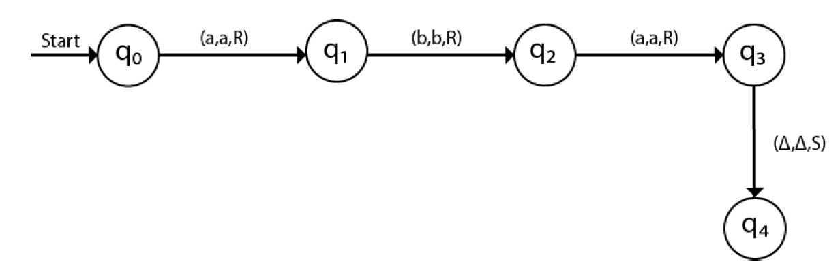
TM Example
The move δ(q3, Δ) = (q4, Δ, R) which means it will go to state q4 which is the HALT state and HALT state is always an accept state for any TM.
The same TM can be represented by Transition Diagram:

Slide 21
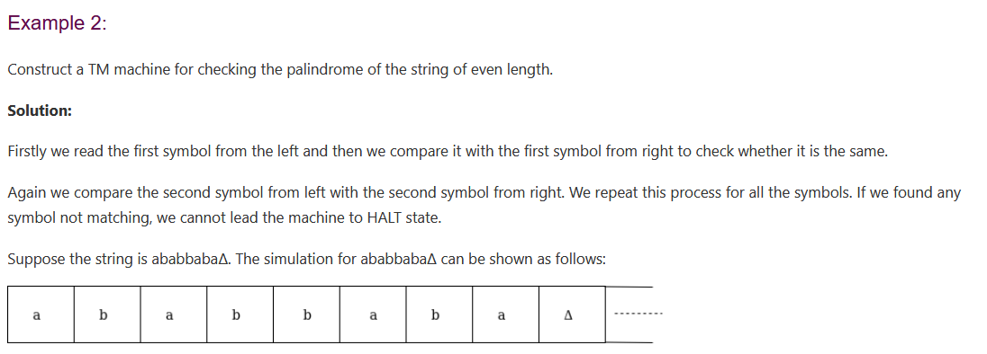
TM Example

Slide 22
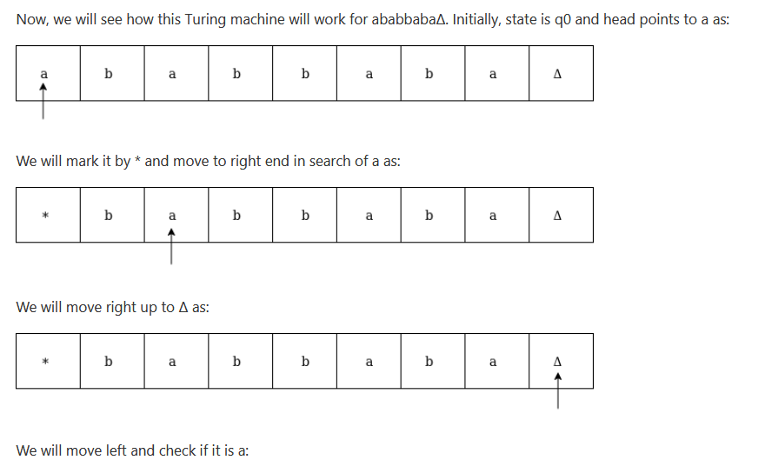
TM Example

Slide 23
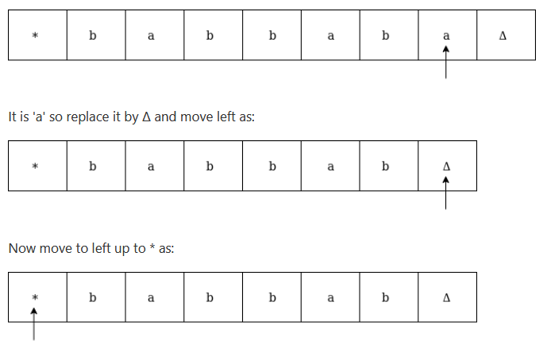
TM Example

Slide 24
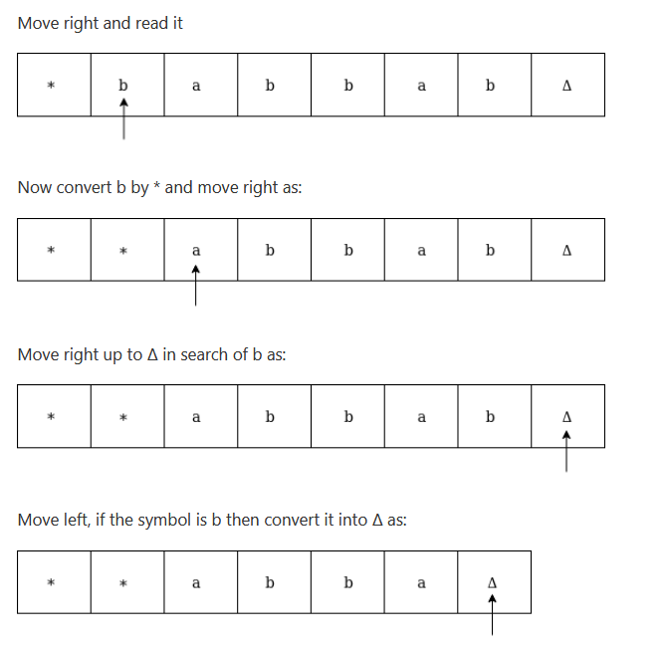
TM Example

Slide 25
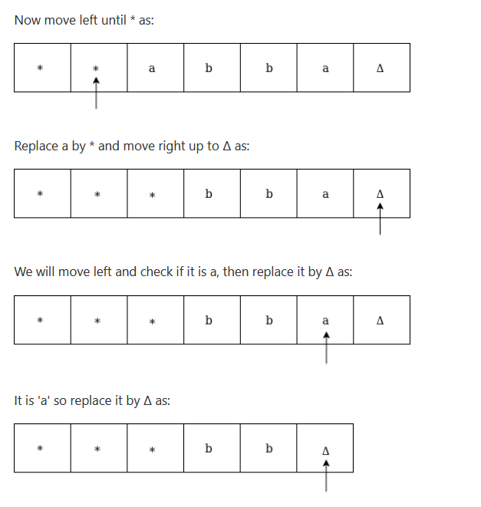
TM Example

Slide 26
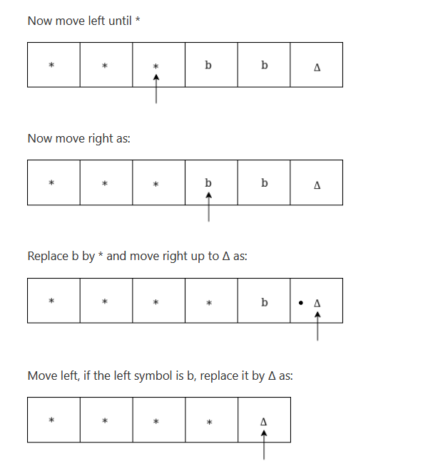
TM Example

Slide 27
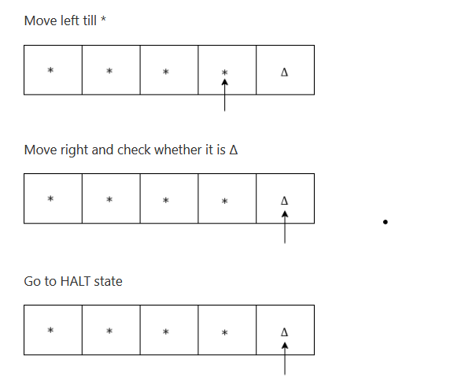
TM Example

Slide 28
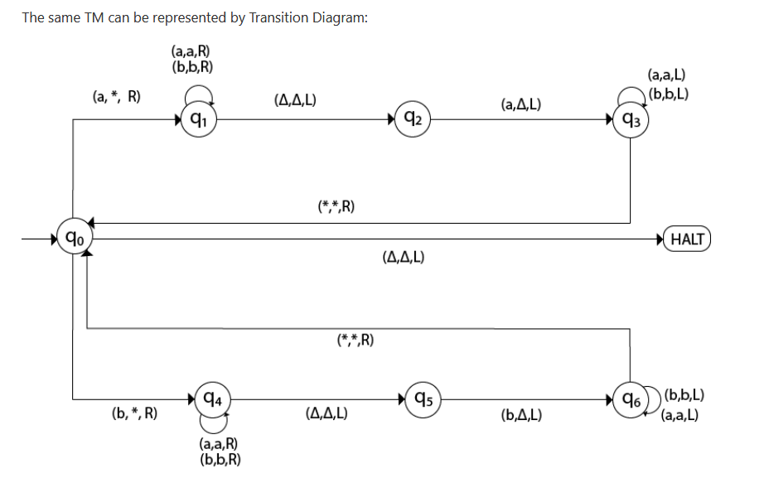
TM Example

Slide 29
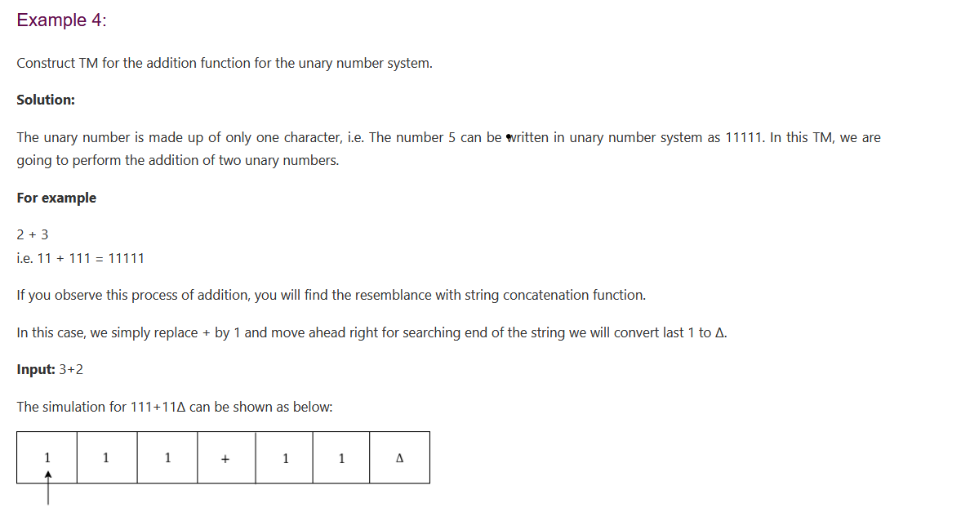
TM Example

Slide 30
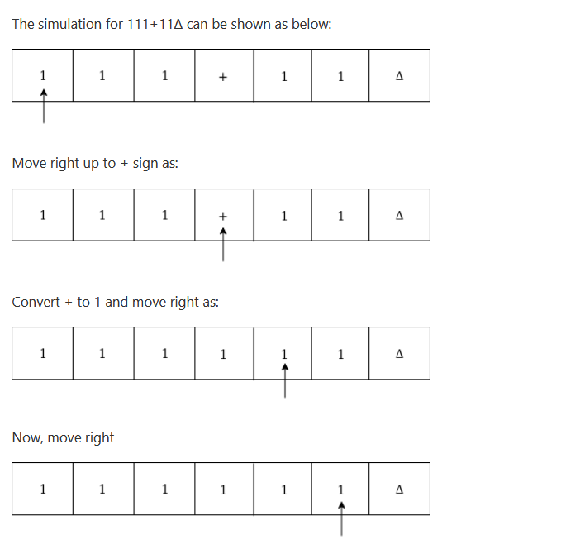
TM Example

Slide 31
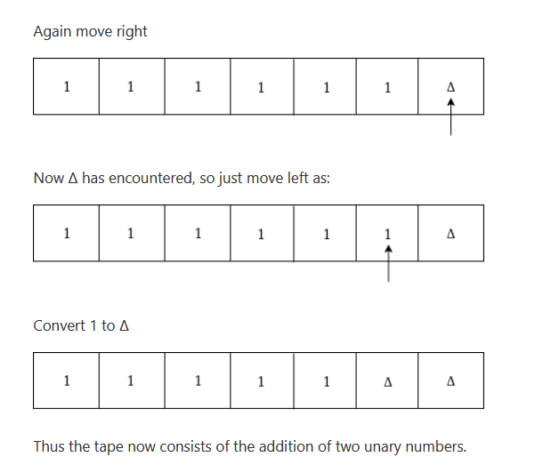
TM Example

Slide 32
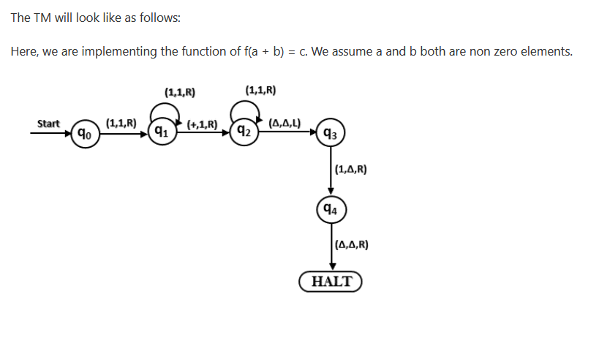
TM Example

Slide 33
Universal Turing Machine (CO1, CO2, CO4)
Recap: Till now we have studied about Turing Machine.
Prerequisite: Basic review of model to perform different operations like addition, subtraction, multiplication.
Objective: To understand the Universal Turing Machine.

Slide 34
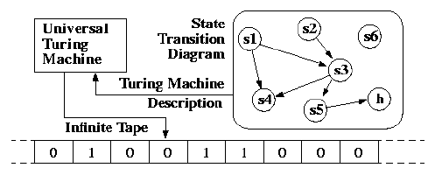
Universal Turing Machine (CO1, CO2, CO4)
Objective: To understand the Universal Turing Machine.
A Turing Machine is the mathematical tool equivalent to a digital computer.
It was suggested by the mathematician Turing in the 30s, and has been since then the most widely used model of computation in computability and complexity theory.
The model consists of an input output relation that the machine computes.
The input is given in binary form on the machine's tape, and the output consists of the contents of the tape when the machine halts.

Slide 35
Universal Turing Machine
What determines how the contents of the tape change is a finite state machine (or FSM, also called a finite automaton) inside the Turing Machine.
The FSM is determined by the number of states it has, and the transitions between them.
At every step, the current state and the character read on the tape determine the next state the FSM will be in, the character that the machine will output on the tape (possibly the one read, leaving the contents unchanged), and which direction the head moves in, left or right.
The problem with Turing Machines is that a different one must be constructed for every new computation to be performed, for every input output relation.
This is why we instroduce the notion of a universal turing machine (UTM), which along with the input on the tape, takes in the description of a machine M.
The UTM can go on then to simulate M on the rest of the contents of the input tape. A universal turing machine can thus simulate any other machine.

Slide 36
Linear Bounded Automata (CO1, CO2, CO4)
Recap: Till now we have studied about Turing Machine and Universal Turing Machine.
Prerequisite: Basic review of model to perform different operations like addition, subtraction, multiplication.
Objective: To understand the Linear Bounded Automata.

Slide 37
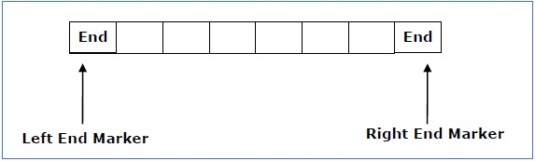
Linear Bounded Automata (CO1, CO2, CO4)
Objective: To understand the Linear Bounded Automata.
A linear bounded automaton is a multi-track non-deterministic Turing machine with a tape of some bounded finite length.
Length = function (Length of the initial input string, constant c)
Here,
Memory information ≤ c × Input information
Link: https://www.youtube.com/watch?v=kFH4X69L1JU

Slide 38
Linear Bounded Automata
A linear bounded automaton can be defined as an 8-tuple (Q, X, ∑, q₀, ML, MR, δ, F) where −
Q is a finite set of states
X is the tape alphabet
∑ is the input alphabet
q₀ is the initial state
M_{L} is the left end marker
M_{R} is the right end marker where M_{R} ≠ M_{L}
δ is a transition function which maps each pair (state, tape symbol) to (state, tape symbol, Constant ‘c’) where c can be 0 or +1 or -1
F is the set of final states

Slide 39
Church’s Thesis (CO5)
Recap: Till now we have studied about Turing Machine, Universal Turing Machine and Linear Bounded Automata.
Prerequisite: Basic review of model to perform different operations like addition, subtraction, multiplication.
Objective: To understand the importance of Church Thesis in Theory of Computation.

Slide 40
Church’s Thesis (CO5)
Objective: To understand the importance of Church Thesis in Theory of Computation.
In 1936, Alonzo Church created a method for defining functions called the λ-calculus. Within λ-calculus, he defined an encoding of the natural numbers called the Church numerals.
Also in 1936, before learning of Church's work, Alan Turing created a theoretical model for machines, now called Turing machines, that could carry out calculations from inputs by manipulating symbols on a tape.
A Turing machine is an abstract representation of a computing device.
It is more like a computer hardware than a computer software.
Link: https://www.youtube.com/watch?v=EEfNU8AoA-8

Slide 41
Church’s Thesis (CO5)
The Church-Turing thesis concerns an effective or mechanical method in logic and mathematics.
A method, M, is called ‘effective’ or ‘mechanical’ just in case:
M is set out in terms of a finite number of exact instructions (each instruction being expressed by means of a finite number of symbols);
M will, if carried out without error, always produce the desired result in a finite number of steps;

Slide 42
Church’s Thesis (CO5)
M can (in practice or in principle) be carried out by a human being unaided by any machinery except for paper and pencil;
M demands no insight or ingenuity on the part of the human being carrying it out.
They gave an hypothesis which means proposing certain facts.
The Church’s hypothesis or Church’s turing thesis can be stated as:
The assumption that the intuitive notion of computable functions can be identified with partial recursive functions.
This statement was first formulated by Alonzo Church in the 1930s and is usually referred to as Church’s thesis, or the Church-Turing thesis.
However, this hypothesis cannot be proved.

Slide 43
Recursive Enumerable (CO1, CO2, CO4)
Recap: Till now we have studied about Turing Machine, Universal Turing Machine, Linear Bounded Automata and Church Thesis.
Prerequisite: Basic review of model to perform different operations like addition, subtraction, multiplication.
Objective: To understand the Recursive Enumerable Language.

Slide 44
Recursive Enumerable (CO1, CO2, CO4)
Objective: To understand the Recursive Enumerable Language.
RE languages or type-0 languages are generated by type-0 grammars.
An RE language can be accepted or recognized by Turing machine which means it will enter into final state for the strings of language and may or may not enter into rejecting state for the strings which are not part of the language.
It means TM can loop forever for the strings which are not a part of the language.
RE languages are also called as Turing recognizable languages.
Link: https://www.youtube.com/watch?v=KJD_F-QGLmo

Slide 45
Recursive Enumerable (CO1, CO2, CO4)
A Recursively enumerable language is the language that accepts every string otherwise not. If a language that halt on every string, then we call it as recursive language.
Problem
We need to prove that the set of all languages that are not recursively enumerable on {a} is not countable.
First let see what the recursive enumerable language is −
Recursive Enumerable Language
A language L is recursively enumerable if L is the set of strings accepted by some TM.
If L is a recursive enumerable language then −
if w ∈ L then a TM halts in a final state,
if w ∉ L then a TM halts in a non-final state or loops forever.
If L is a recursive language then −
if w ∈ L then a TM halts in a final state,
if w ∉ L then TM halts in a non-final state.

Slide 46
Halting Problem (CO1, CO2, CO4)
Recap: Till now we have studied about Turing Machine, Universal Turing Machine, Linear Bounded Automata, Church Thesis and Recursive Enumerable Language.
Prerequisite: Basic review of model to perform different operations like addition, subtraction, multiplication.
Objective: To understand the Halting Problem in theory of computations.

Slide 47
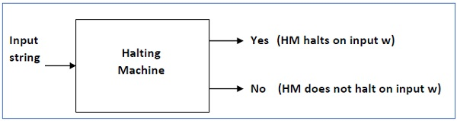
Halting Problem (CO1, CO2, CO4)
Objective: To understand the Halting Problem in theory of computations.
Input − A Turing machine and an input string w.
Problem − Does the Turing machine finish computing of the string w in a finite number of steps? The answer must be either yes or no.
Link for Further Explanation:
https://www.youtube.com/watch?v=mx1mnyagfdM&list=PL4B084328ED81F3AF

Slide 48
Post Correspondence Problem (CO1, CO2, CO4)
Recap: Till now we have studied about Turing Machine, Universal Turing Machine, Linear Bounded Automata, Church Thesis, Recursive Enumerable Language and Halting Problem.
Prerequisite: Basic review of model to perform different operations like addition, subtraction, multiplication.
Objective: To understand the importance of post correspondence problem.

Slide 49
Post Correspondence Problem (CO1, CO2, CO4)
Objective: To understand the importance of post correspondence problem.
The Post Correspondence Problem (PCP), introduced by Emil Post in 1946, is an undecidable decision problem. The PCP problem over an alphabet ∑ is stated as follows −
Given the following two lists, M and N of non-empty strings over ∑
M = (x₁, x₂, x₃,………, x_{n})
N = (y₁, y₂, y₃,………, y_{n})
We can say that there is a Post Correspondence Solution, if for some i₁,i₂,………… i_{k}, where 1 ≤ i_{j} ≤ n, the condition x_{i1} …….x_{ik} = y_{i1} …….y_{ik} satisfies.
Link for further explanation :
https://www.youtube.com/watch?v=YSr5zmVqZLI

Slide 50
Post Correspondence Problem
Problem:
Find whether the lists M = (abb, aa, aaa) and N = (bba, aaa, aa)
have a Post Correspondence Solution?
Solution:
Here,
x₂x₁x₃ = ‘aaabbaaa’
and y₂y₁y₃ = ‘aaabbaaa’
We can see that
x₂x₁x₃ = y₂y₁y₃
Hence, the solution is i = 2, j = 1, and k = 3.
 | x₁ | x₂ | x₃
M | Abb | aa | aaa
N | Bba | aaa | aa

Slide 51
Faculty Video Links, Youtube & NPTEL Video Links and Online Courses Details
Youtube/other Video Links
https://www.youtube.com/watch?v=IhyEGNn-7Uo
https://www.youtube.com/watch?v=BR6fHjKFqa0
https://www.youtube.com/watch?v=vhSMp91tS6k
https://www.youtube.com/watch?v=mPec64RUCsk
https://www.youtube.com/watch?v=moPtwq_cVH8

Slide 52
Daily Quiz
Design a TM to compute the function f(n)=n²
Explain Church’s Thesis.
Define Post Correspondence Problem and Modified Post Correspondence Problem.
Design a TM to accept the language “ The set of strings with an equal number of 0’s and 1’s.
Design a right shift TM over an alphabet{0,1}
Write short note on Halting Problem.

Slide 53
Daily Quiz (Continued)
7. Define Basic model of Turing Machine.
8. Explain the techniques for Turing Machine construction.
9. Explain Church’s Thesis.
10. Design a TM to compute the function f(n)=n²
11. Define Post Correspondence Problem and Modified Post
Correspondence Problem.
12. Write short note on Universal Turing Machine.
13. When a language is said to be recursive or recursively
enumerable.
14. Write short note on Halting Problem.
15. Design a right shift TM over an alphabet{0,1}.

Slide 54
Weekly Assignment
https://drive.google.com/file/d/13kK3291TzguwU6GAA8vIqrRw6w_13ypj/view?usp=sharing

Slide 55
MCQ s
1. Find the odd one :
Multiple track
Subroutines
Recursion
Shifting over
2. Which operation is not a part of TM?
Enter Accepting State
Enter Non Accepting state
Enter infinite loop and never halts
None of the above

Slide 56
MCQ s (Continued)
3. Which of the statement is not true for TM?
Computers of functions on non negative numbers
Language Recognition
Generating devices
None
4. A finite control of TM is used in order to hold a finite amount of data. Say True or False:
TRUE
FALSE
May Be
Cant Say

Slide 57
MCQ s (Continued)
5. Find the odd one :
Multiple track
Subroutines
Recursion
Shifting over
6. Which operation is not a part of TM?
Enter Accepting State
Enter Non Accepting state
Enter infinite loop and never halts
None of the above

Slide 58
MCQ s (Continued)
7. Which of the statement is not true for TM?
Computers of functions on non negative numbers
Language Recognition
Generating devices
None
8. X is a simple mathematical model of a computer. X has unrestricted and unlimited memory. X is a FA with R/W head. X can have an infinite tape divided into cells, each cell holding one symbol. Name X?
NDFA
PDA
TM
None of the above

Slide 59
Old Question Papers
https://drive.google.com/file/d/12YgCV_q7QeE1d_Hp0JrOWRFgXOcdKSRc/view?usp=sharing
https://drive.google.com/file/d/1J5wqcdUF3nf_8UMcYD_wTblTK3SmChqr/view?usp=sharing
https://drive.google.com/file/d/1VxIo8y0ZSdXXcHYLwUgii9MuZEosGGyC/view?usp=sharing
https://drive.google.com/file/d/1ZlOKf6Il9xwPF6YlmSGAsFSsAjT4fNPu/view?usp=sharing
https://drive.google.com/file/d/1dyqbDpBPuY50gsmu62JcVtgD65t_0lu4/view?usp=sharing

Slide 60
Expected Questions for University Exam
Design a TM to reverse a string over an alphabet {0,1}.
Design a TM to check whether a string over {a,b}contains equal number of a’s and b’s.
Design a TM that replace every occurrence of abb by baa.
Design a TM for addition of Unary numbers.
Design a TM for subtraction of a Unary numbers.

Slide 61
Summary
Turing machines use an infinite tape divided into a number of rectangular cells and a tape head that can read and write symbols and can move in both the directions left and right.
The input for a transition function of a TM are current state and current tape symbol.
The output of the transition function are the state in which TM has to be after reading the current tape symbol.

Slide 62
References
Aho, Hopcroft and Ullman, The Design and Analysis of Computer Algorithms, Addison Wesley.
Aho, Sethi, Ullman, Compilers Principles, Techniques and Tools, Pearson Education, 2003.
Hopcroft and Ullman, Introduction to Automata Theory, Languages and Computation, Addison Wesley.
Kohavi, ZVI, Switching And Finite Automata Theory, Tata McGraw-Hill, 2006.
Lewis and Papadimitriou, Elements of the Theory of Computation, Prentice-Hall.
Martin, Introduction to Languages and the Theory of Computation, McGraw-Hill, 2nd edition,1996.
Mishra, KLP, Chandrasekaran, N. Theory of Computer Science, (Automata, Languages and Computation) PHI, 2002.

Slide 63
Noida Institute of Engineering and Technology, Greater Noida
Thank You

